Slide 1



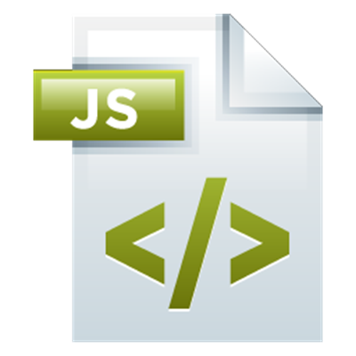


JavaScript Syntax: Basic Web
Syntax, Conditions, Loops, Functions, Objects, Arrays
JS
SoftUni Team
Technical Trainers
Software University
http://softuni.bg

Slide 2



Table of Contents
Welcome to JavaScript
Variables and Operators
Conditions: if-else, switch
Loops: for, while, do-while, …
Functions
Objects
Arrays
Strings

Slide 3
Have a Question?
sli.do #tech-softuni

Slide 4

Welcome to JavaScript!
Syntax and Comparison

Slide 5
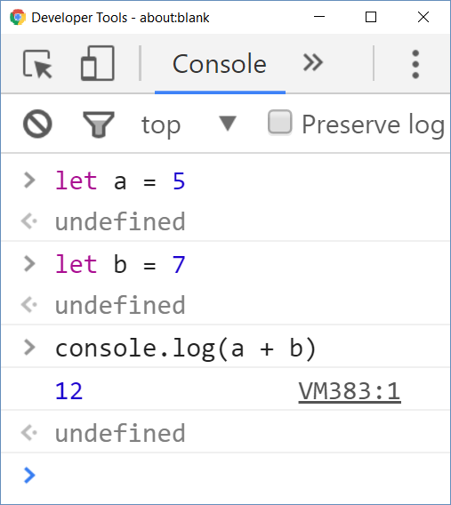
Welcome to JavaScript
JavaScript (JS) is a scripting language
Executes commands (script)
Can work in interactive mode
No compilation, just execute commands
C# / Java are statically-typed languages
Programs are first compiled
Then the compiled binary is executed

Slide 6
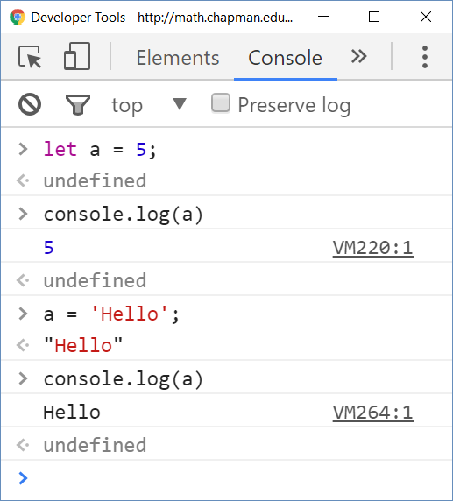
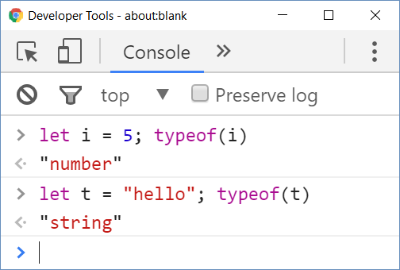
Welcome to JavaScript (2)
JavaScript (JS) is untyped language
Untyped (dynamically typed) == variables have no types
Data (values) still have a type

Slide 7
Variables and Operators in JS
Define variables with the keyword let
let i = 5; let j = 3; // i and j are numbers
console.log(typeof(i)) // Number
i = i * j; i++; // 16
console.log(i + 1); // 17
The ; can be omitted
let str = 'Hello'; // string
str = str + " JS";
console.log(str); // Hello JS
Strings are in format '…' or "…"
Undefined identifier usage
console.log(s2); // Uncaught ReferenceError: s2 is not defined

Slide 8
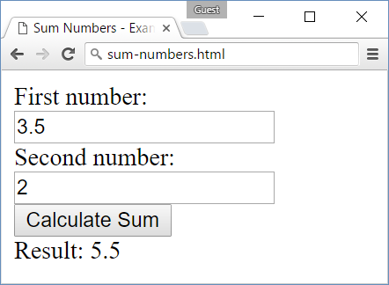
Problem: Sum Numbers with HTML and JS
Write an HTML form holding two text fields
Write some JS code to sum their values
<form>
<div>First number:</div>
<div><input type="number" id="num1" /></div>
<div>Second number:</div>
<div><input type="number" id="num2" /></div>
<div><input type="button" value="Calculate Sum" onclick="sumNumbers()" /></div>
<div>Result: <span id="result" /></div>
</form>

Slide 9
Solution: Sum Numbers with HTML and JS
Write the JavaScript code in a <script>…</script> snippet
Use camelCase for function names
The { stays on the same line
<script>
function sumNumbers() {
let num1 = document.getElementById('num1').value;
let num2 = document.getElementById('num2').value;
let sum = Number(num1) + Number(num2);
document.getElementById('result').innerHTML = sum;
}
</script>
In this course we use the latest JS version: ECMAScript 2016 (a.k.a. ES2016 or ES7)

Slide 10
Problem: Calculate Expression
Write a JavaScript program to print the value of the following expression: ((30 + 25) * 1/3 * (35 - 14 - 12))²
Sample solution:
let val = ((30 + 25) / 3 * (35 - 14 - 12)) ** 2;
console.log(val);
Exponentiation operator
Check your solution here: https://judge.softuni.bg/Contests/Practice/Index/223#0

Slide 11
Solution: Calculate Expression
To submit the above solution in the SoftUni Judge
Put your code in a JS function:
The function takes the input as an array of strings and prints the output on the console
function (arr) {
let val = ((30 + 25) / 3 * (35 - 14 - 12)) ** 2;
console.log(val);
}
Check your solution here: https://judge.softuni.bg/Contests/Practice/Index/223#0

Slide 12
Problem: Sum Two Numbers
Write a JS function to sum two numbers given as array of strings
function sum(nums) {
let num1 = Number(nums[0]);
let num2 = Number(nums[1]);
let sum = num1 + num2;
return sum;
}
Test this function in the judge system
Invoke the above function to test it locally
sum(['10', '20’]); // returns 30
Check your solution here: https://judge.softuni.bg/Contests/Practice/Index/223#1

Slide 13

Type Conversions
All JS types can be compared due to automatic type conversion
More examples to play with:
WAT, JS Weird Parts
5 == "5.0" // true (== checks value)
5 === "5.0" // false (=== checks type + value)
1 == true // true
[] == false // true
'' == false // true
"" == 0 // true
5 + false + true === 6 // true

Slide 14
Conditions: if-else
JavaScript implements the classical if / if-else statements:
let number = 5;
if (number % 2 == 0) {
console.log("Even number");
} else {
console.log("Odd number");
}

Slide 15
Problem: Three Integers Sum
You are given 3 integers
Check whether two of them are equal to the third
Print the output in format a + b = c (a ≤ b)
8 15 7
7 + 8 = 15
3 8 12
No
-5 -3 -2
-3 + -2 = -5
0 0 0
0 + 0 = 0
Check your solution here: https://judge.softuni.bg/Contests/Practice/Index/223#2

Slide 16
Solution: Three Integers Sum
function threeIntegersSum(arr) {
let nums = arr[0].split(' ').map(Number);
console.log(
check(nums[0], nums[1], nums[2]) ||
check(nums[0], nums[2], nums[1]) ||
check(nums[1], nums[2], nums[0]) || 'No');
function check(num1, num2, sum) {
if (num1 + num2 != sum)
return false;
if (num1 > num2)
[num1, num2] = [num2, num1]; // Swap num1 and num2
return `${num1} + ${num2} = ${sum}`;
}
}
Print the first non-false expression
Nested function: returns either a string or false
String interpolation
threeIntegersSum(['8 15 7'])
Check your solution here: https://judge.softuni.bg/Contests/Practice/Index/223#2

Slide 17
The switch-case Statement
Selects a statement from a list depending on the value of the switch expression
let day = 3
switch (day) {
case 1: console.log('Monday'); break;
case 2: console.log('Tuesday'); break;
case 3: console.log('Wednesday'); break;
…
case 7: console.log('Sunday'); break;
default: console.log('Error!'); break;
}

Slide 18
Loops: for, while, do-while, …
The for / while / do-while loops work as in C# and Java
for (let i = 0; i <= 10; i++)
console.log(i); // 0 1 2 3 4 … 10
let count = 1
while (count < 1024)
console.log(count *= 2); // 2 4 8 16 … 1024
let s = "ha"
do { console.log(s); s = s + s; }
while (s.length < 10); // ha haha hahahaha

Slide 19
Problem: Symmetric Numbers
Write a JS function that finds and prints all symmetric numbers in the range [1…n]
1 2 3 4 5 6 7 8 9 11 22 33 44 55 66 77 88 99 101 111 121 131 141 151 161 171 181 191 202 212 222 232 242 252 262 272 282 292 303 313 323 333 343 353 363 373 383 393 404 414 424 434 444 454 464 474 484 494 505 515 525 535 545 555 565 575 585 595 606 616 626 636 646 656 666 676 686 696 707 717 727 737 747
750
Check your solution here: https://judge.softuni.bg/Contests/Practice/Index/223#3

Slide 20
Solution: Symmetric Numbers
function symmetricNumbers(arr) {
let n = Number(arr[0]), result = ''
for (let i = 1; i <= n; i++)
if (isSymmetric(i.toString()))
result += i + " "
console.log(result)
function isSymmetric(str) {
for (let i = 0; i < str.length / 2; i++)
if (str[i] != str[str.length - i - 1])
return false
return true
}
}
symmetricNumbers(['1000']);
Check your solution here: https://judge.softuni.bg/Contests/Practice/Index/223#3

Slide 21
Functions
Functions in JS hold a piece of code (script)
Can take parameters and return result
Similar to functions in C and PHP and methods in C++ / C# / Java
function multiply(a, b) {
return a * b;
}
console.log(multiply(2, 3)); // 6 == 2 * 3
console.log(multiply(2)); // NaN == 2 * undefined
console.log(multiply(5, 6, 7)); // 30 == 5 * 6

Slide 22
Anonymous Functions and Callbacks
let print = function(x) { console.log(x) };
[10, 20, 30].forEach(print) // 10 20 30
let sum = 0;
[10, 20, 30].forEach(function(x) {
sum += x;
});
console.log(sum) // 60
(function(text) { alert(text) })("hello")

Slide 23
Block Scope vs. Function Scope
var defines "function scope“
Use var carefully!
(function functionScope() {
console.log(x); // undefined
for (var x = 1; x < 10; x++)
console.log(x);; // 1 … 9
console.log(x); // 10
var x = 5; console.log(x); // 5
var x = 2; console.log(x); // 2
x = 3; console.log(x) // 3
}) ();

Slide 24
Block Scope vs. Function Scope (2)
let defines "block scope"
Prefer let in most cases
(function blockScope() {
// console.log(x); // error!
let x = 5; console.log(x); // 5
for (let x = 20; x < 30; x++)
console.log(x); // 20 … 29
console.log(x); // 5
x = 10; console.log(x); // 10
// let x = 5; // error!
}) ();

Slide 25

Objects
Objects in JavaScript hold key-value pairs:
let obj = { name : "SoftUni", age : 2 };
console.log(obj); // Object {name: "SoftUni", age: 2}
obj['site'] = "http://www.softuni.bg";
obj.age = 10;
obj['name'] = "Software University";
console.log(obj); // Object {name: "Software University", age: 10, site: "http://www.softuni.bg"}
delete obj.name;
delete obj.site;
console.log(obj); // Object {age: 10}

Slide 26


Objects and JSON
JavaScript objects can be stored as text in JSON format
let obj = { name : "SoftUni", age : 2 }
let str = JSON.stringify(obj)
console.log(str) // {"name":"SoftUni","age":2}
let str = "{\"name\":\"Nakov\",\"age\":24}"
let obj = JSON.parse(str)
console.log(obj) // Object {name: "Nakov", age: 24}

Slide 27
Problem: Sums by Town
You are given a sequence of JSON strings holding town + income
Write a JS function to sum and print the incomes for each town
{"town":"Sofia","income":200}
{"town":"Varna","income":120}
{"town":"Pleven","income":60}
{"town":"Varna","income":70}
Towns can appear multiple times
Pleven -> 60
Sofia -> 200
Varna -> 190
Order the towns by name
Check your solution here: https://judge.softuni.bg/Contests/Practice/Index/223#4

Slide 28
Solution: Sums by Town
function calcSumsByTown(arr) {
let objects = arr.map(JSON.parse);
let sums = {};
for (let obj of objects)
if (obj.town in sums)
sums[obj.town] += obj.income;
else
sums[obj.town] = obj.income;
let towns = Object.keys(sums).sort();
for (let town of towns)
console.log(`${town} -> ${sums[town]}`);
}
Check your solution here: https://judge.softuni.bg/Contests/Practice/Index/223#4

Slide 29
Arrays in JavaScript
Arrays in JS can hold mixed types:
// Array holding numbers
let numbers = [1, 2, 3, 4, 5];
// Array holding strings
let weekDays = ['Monday', 'Tuesday', 'Wednesday',
'Thursday', 'Friday', 'Saturday', 'Sunday'];
// Array of mixed data
var mixedArr = [1, new Date(), 'hello'];

Slide 30
Processing Arrays Elements
Print all elements of an array of strings:
let capitals = ['Sofia', 'Washington', 'London', 'Paris'];
for (let capital of capitals)
console.log(capital);
for (let i in capitals)
console.log(capitals[i]);
for (let i = 0; i < capitals.length; i++)
console.log(capitals[i]);
Works like foreach
This is not foreach! It goes through the array indices.
Traditional for-loop

Slide 31
Array Operations
let numbers = [1, 2, 3, 4];
console.log(numbers.join('|')); // result: 1|2|3|4|5
numbers.push(5);
console.log(numbers.join('|')); // result: 1|2|3|4|5
let tail = numbers.pop(); // tail = 5;
console.log(numbers.join('|')); // result: 1|2|3|4
numbers.unshift(0);
console.log(numbers.join('|')); // result: 0|1|2|3|4
let head = numbers.shift(); // head = 0;
console.log(numbers.join('|')); // result: 1|2|3|4

Slide 32
Problem: Largest 3 Numbers
Write a program to read an array of numbers and find and print the largest 3 of them
10
30
15
20
50
5
50
30
20
20
30
30
20
10
5
20
3
20
20
20
10
Check your solution here: https://judge.softuni.bg/Contests/Practice/Index/223#5

Slide 33
Solution: Largest 3 Numbers
function largest3Numbers(arr) {
let nums = arr.map(Number);
let numsSorted = nums.sort((a, b) => b - a);
let count = Math.min(3, arr.length);
for (let i = 0; i < count; i++)
console.log(numsSorted[i]);
}
largest3Numbers(['10', '30', '15', '20', '50', '5'])
Check your solution here: https://judge.softuni.bg/Contests/Practice/Index/223#5

Slide 34
Strings
Strings in JavaScript hold a sequence of Unicode characters
let str1 = "Some text in a string variable";
let str2 = 'Text enclosed in single quotes';
for (let i = 0; i < str1.length; i++)
console.log(str1[i] + ' ' + str2[i]);
let tokens = 'C#, Java, PHP ,HTML'.split(',');
// tokens = ['C#', ' Java', ' PHP ', 'HTML']
tokens = tokens.map(s => s.trim());
console.log(tokens);
// ['C#', 'Java', 'PHP', 'HTML']
Map by lambda function

Slide 35
Problem: Extract Capital-Case Words
Write a JavaScript function to extract from array of strings all capital-case words. All non-letter chars are considered separators.
We start by HTML, CSS, JavaScript, JSON and REST.
Later we touch some PHP, MySQL and SQL.
Later we play with C#, EF, SQL Server and ASP.NET MVC.
Finally, we touch some Java, Hibernate and Spring.MVC.
HTML, CSS, JSON, REST, PHP, SQL, C, EF, SQL, ASP, NET, MVC, MVC
Check your solution here: https://judge.softuni.bg/Contests/Practice/Index/223#6

Slide 36
Solution: Extract Capital-Case Words
function extractCapitalCaseWords(arr) {
let text = arr.join(",");
let words = text.split(/\W+/);
let nonEmptyWords = words.filter(w => w.length > 0);
let upWords = nonEmptyWords.filter(isUppercase);
console.log(upWords.join(", "));
function isUppercase(str) {
return str === str.toUpperCase();
}
}
extractCapitalCaseWords(['PHP, Java and HTML'])
Check your solution here: https://judge.softuni.bg/Contests/Practice/Index/223#6

Slide 37

Summary
JavaScript is a dynamically-typed language
Commands are arranged in scripts
Program logic (variables, conditions, loops) are similar to C# / Java / PHP / C++
Arrays in JS combine traditional arrays, lists and dictionaries
Objects in JS hold key-value pairs
JS is a functional language: relies on functions, callbacks, lambdas, etc.

Slide 38










JavaScript Basics
https://softuni.bg/courses/software-technologies

Slide 39
License
This course (slides, examples, demos, videos, homework, etc.) is licensed under the "Creative Commons Attribution-NonCommercial-ShareAlike 4.0 International" license

Slide 40





Trainings @ Software University
Software University Foundation – softuni.org
Software University – High-Quality Education, Profession and Job for Software Developers
softuni.bg
Software University @ Facebook
facebook.com/SoftwareUniversity
Software University Forums – forum.softuni.bg

